Slide 1

CFC PERFORMANCE INSIGHTS VIZATHON DATA GUIDE
SIMPLE | ILLUMINATING | ACTIONABLE

Slide 2
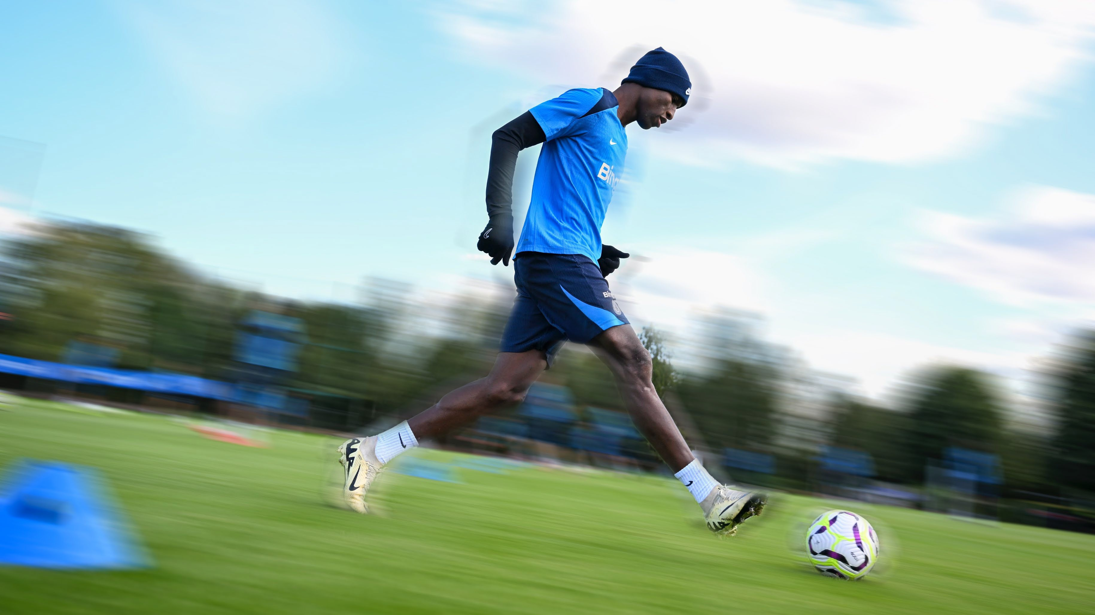
GPS DATA
SIMPLE | ILLUMINATING | ACTIONABLE

Slide 3
GPS DATA
GPS performance metrics track movement demands, including speed, distance, and acceleration, to assess workload and physical output. This dataset contains simulated data for 1 player.
date: The date of the recorded session or match opposition_code: A unique identifier for the opposing team opposition_full: The full name of the opposing team
md_plus_code: A marker for the number of days after a match (e.g., MD+1 refers to one day post-match) md_minus_code: A marker for the number of days before a match (e.g., MD-1 refers to one day before a match) season: The football season during which the data was recorded
distance: The total distance covered by a player during the session or match, measured in meters or kilometers
distance_over_21: The distance covered at a speed above 21 km/h distance_over_24: The distance covered at a speed above 24 km/h distance_over_27: The distance covered at a speed above 27 km/h accel_decel_over_2_5: The number of accelerations or decelerations above 2.5 m/s² accel_decel_over_3_5: The number of accelerations or decelerations above 3.5 m/s² accel_decel_over_4_5: The number of accelerations or decelerations above 4.5 m/s² day_duration: The duration of the session in minutes
peak_speed: The highest speed recorded during the session hr_zone_1_hms: The total time spent in heart rate zone 1 (50-60% Max HR) hr_zone_2_hms: The total time spent in heart rate zone 2 (60-70% Max HR) hr_zone_3_hms: The total time spent in heart rate zone 3 (70-80% Max HR) hr_zone_4_hms: The total time spent in heart rate zone 4 (80-90% Max HR) hr_zone_5_hms: The total time spent in heart rate zone 5 (90-100% Max HR)
CFC PERFORMANCE INSIGHTS
SIMPLE | ILLUMINATING | ACTIONABLE

Slide 4
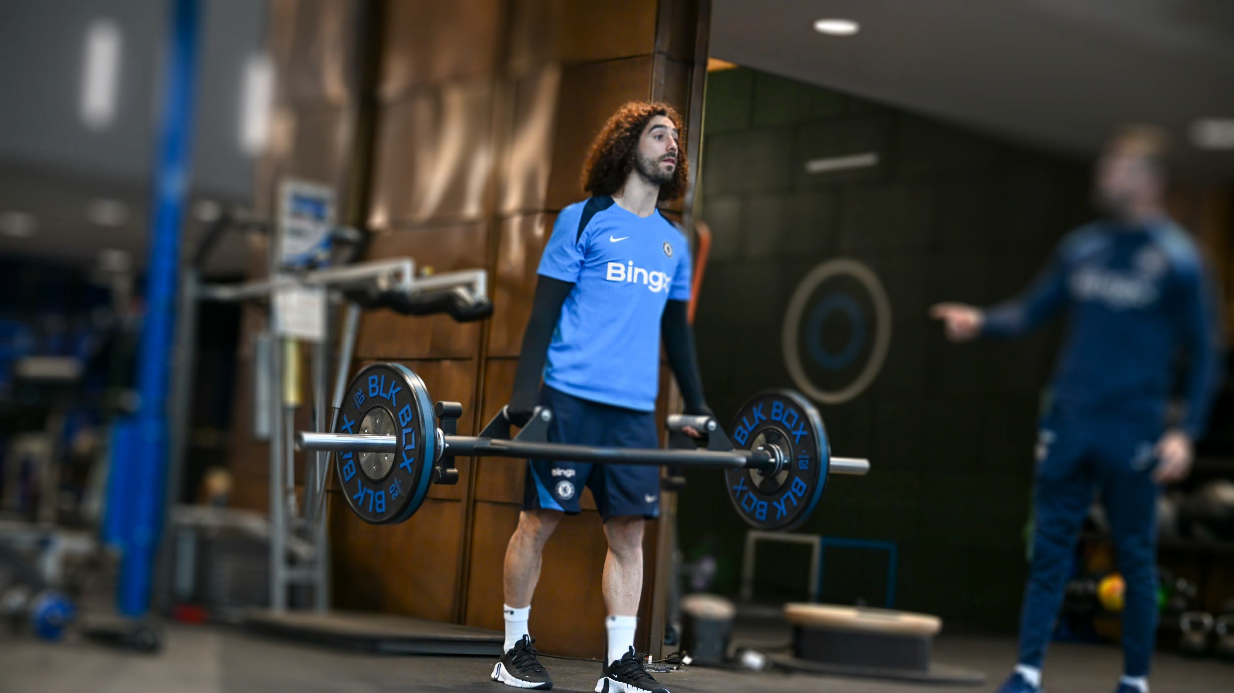
PHYSICAL CAPABILTY DATA
SIMPLE | ILLUMINATING | ACTIONABLE

Slide 5
PHYSICAL CAPABILITY
Physical Capability is measured using a battery of tests which measure different qualities and expressions of force.
The dataset provided contains the longitudinal data for 1 player for the past 2+ seasons. The data has been aggregated to the MOVEMENT, QUALITY and EXPRESSION level, so scores are not available for the specific tests and metrics that lie in the layers underneath.
Where sufficient data exists, the “BenchmarkPct” value will be available. This is a pre-calculated aggregate expressed as a percentage. There is 1 row per movement/quality/expression per day. If no new data has been recorded on a given day, data from the previous day is carried forward.
MOVEMENTS – The movement category that the values belong to Agility: qualities relating to change of direction and agility ability Sprint: qualities relating to maximum speed
Upper Body: qualities relating to upper body strength
Jump: qualities relating to jumping ability
QUALITY – The specific quality that supports the movement. A quality can belong to more than one movement and may be measured in more than one expression. Acceleration: ability to speed up
Deceleration: ability to slow down Grapple: ability to hold strong and push Land: landing from a jump
Max velocity: qualities
Pre-load: ability to store energy prior to a jump or change of direction
Pull: upper body pull strength
Push: upper body push strength
Rotate: ability to produce and resist rotations
Take off: vertical propulsive qualities
EXPRESSION – The type of force expression that is measured for the quality. A quality can be measured in both Isometric and Dynamic expressions Isometric: qualities of maximum force expressed against a fixed surface with no movement of the joints
Dynamic: qualities of force and power production that involve movement such as a vertical jump or hop test
CFC PERFORMANCE INSIGHTS SIMPLE | ILLUMINATING | ACTIONABLE

Slide 6

RECOVERY STATUS DATA
SIMPLE | ILLUMINATING | ACTIONABLE

Slide 7
RECOVERY STATUS
Recovery status is measured using several tests and metrics to inform recovery strategies throughout the season. This dataset contains simulated data for 1 player.
The tests used to monitor recovery belong to one of 6 categories
The 6 categories above have 2 metrics each
Bio: blood biomarker analysis to assess signs of inflammation that may be due to fatigue or illness. Collected
Msk_joint_range: the joint range of ankles, knees and hips. Collected around once per week
Msk_load_tolerance: the ability of the thigh and hip muscles to produce & tolerate force. Collected around once per week Subjective: perceived level of recovery submitted by the player. Collected on most days except match days and days off Soreness: self reported muscle soreness
Sleep: perceived quality of previous nights sleep
_completeness: percentage completeness of all the tests that are pooled within the category. Values can range from 0 to 1 (0 to 100%)
_composite: The category composite score, expressed as a percentage is relative to the player’s normative values. E.g. value of
-0.50 (-50%) means that on that day, the player was 50% lower than their normative value in that category
In addition to the categories, there is also a pre-calculated aggregated “total” category. This category contains only 1 metric which is called “emboss_baseline_score” and is an aggregation of all the “…basline_composite” values on that day. This can be used as the overall recovery score.
When value = null then the data was not collected for that metric on that day. When value = 0 it was collected. This is a real 0
CFC PERFORMANCE INSIGHTS
SIMPLE | ILLUMINATING | ACTIONABLE

Slide 8

INDIVIDUAL PRIORITY AREAS
SIMPLE | ILLUMINATING | ACTIONABLE

Slide 9
INDIVIDUAL PRIORITY AREAS
Individual priority areas are identified and reviewed by the player and Performance Support Team.
These priorities should be displayed in a prominent way to engage players and staff and encourage collaboration.
Priority | Category | Area | Target | Performance Type | Target set | Review Date | Tracking
1 | Recovery | Sleep | Increase average sleep by 1hr per night | Habit | 07/03/2025 | 07/05/2025 | On Track
2 | Recovery | Nutrition | 45g of carbohydrate every half time | Habit | 07/03/2025 | 07/05/2025 | On Track
3 | Performance | Sprint | >65% in max velocity score | Outcome | 07/03/2025 | 07/05/2025 | Achieved
CFC PERFORMANCE INSIGHTS
SIMPLE | ILLUMINATING | ACTIONABLE

Slide 10


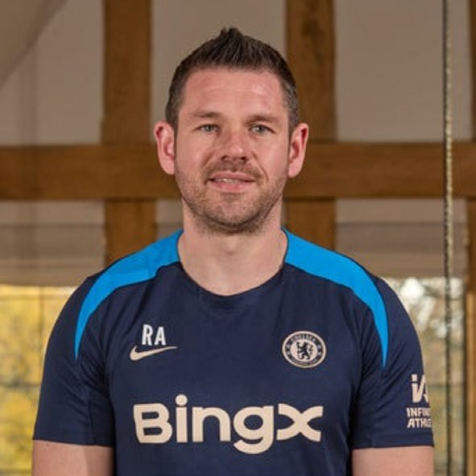

GET IN TOUCH
If you have any questions about the data, need further clarification, or require additional insights, feel free to reach out to the CFC Performance Insights Team
RICHARD AKENHEAD
Head of Performance Insights richard.akenhead@chelseafc.com
EMMANUEL (MANNY) FAJEMILUA
Performance Insights Analyst emmanuel.fajemilua@chelseafc.com
SIMPLE | ILLUMINATING | ACTIONABLE

